Slide 1





E-COMMERCE SALES ANALYSIS
Team : Dharunesh & tharunesh144@gmail.com Guide: P.Raja
Disclaimer: The content is curated for educational purposes only.
Notes:
Slides: Prepare a short slide deck (10-12 slides) summarizing the project objectives, methodology, and key results.

Slide 2
OUTLINE
Abstract of the Project
Problem Statement
Proposed Solution
System Architecture
Live Demo of the Project
Embedded Video of Project
Conclusion
Future Scope

Slide 3
Abstract
This dissertation was written as a part of the MSc in e-Business, Innovation & Entre_x0002_preneurship of the International Hellenic University, and was conducted in cooperation with iTrust.gr, which is an Internet marketing agency offering holistic digital solutions, based in Thessaloniki. The thesis has dealt with the subject of “A novel digital market_x0002_ing approach for the Conversion Rate Optimization for e-Commerce in the fashion and beauty sectors”.
The aim of this thesis is to develop a guideline of best practices on some key factors that affect Conversion Rate Optimization and touch upon Online User Behavior. The disser_x0002_tation firstly approaches some key metrics that are used in terms of measuring the usa_x0002_bility of an e-shop, and the techniques and methods that are being used in order to im_x0002_plement conversion goals of e-commerce companies. At the same time, some best prac_x0002_tices that are being used by leaders in the market are also hereby examined.
The empirical part of the thesis was conducted with a questionnaire-based survey, that had as a goal to define the e-shops’ users opinion and point of view towards some key factors and elements of the e-shops, that affect its performance on key conversion metrics.
At this point, I would also like to thank all those who contributed to the completion of this thesis, such as my family, my friends, my supervisor Dr. Christos Berberis's, and the people at iTrust.gr, who gave me guidance and useful advice on my dissertation, and
of course, all those who took part in my survey and helped me complete the research.

Slide 4
Problem Statement
Despite the fact that Conversion Rate Optimization is a topic that has been dealt with for quite some years now, according to Owen (2010), many businesses still falter when it comes to converting traffic into sales. Geoff Galat (2011), Vice President of market_x0002_ing at Tealeaf, claimed that marketing professionals are stuck at a 92:1 ratio - 92£ are being spent driving traffic to the company’s website and only 1£ is spent on working
with conversions. This points out that there is a significant gap in the priorities of the
companies’ online marketing strategies and budgets.
➢ Identifying and selecting the right analytics data to extract in order to proceed
with the Conversion Optimization of their websites.
➢ Identifying the most valuable pages of their websites to be optimized.

Slide 5
Proposed Solution
A comprehensive solution for sales analysis in e-commerce involves collecting, processing, analyzing, and visualizing data to derive actionable insights that can improve business performance. Below is a proposed solution with key components for building an effective sales analysis framework.
Data Collection & Integration:Collect data on transactions, products sold, quantities, prices, discounts, returns, etc. Ensure data sources are integrated, including platforms like Shopify, WooCommerce, Magento, and marketplaces like Amazon or eBay.
Data Cleaning & Preprocessing: Standardize units (e.g., currency, product names, etc.) and ensure consistency in product IDs, customer information, and timestamps.
Sales Forecasting:Implement predictive analytics to forecast future sales based on historical data and trends. This can help you prepare for demand fluctuations, optimize inventory levels, and plan marketing campaigns.
Customer Segmentation & Personalization:Segment your customer base to better understand and target different groups. Common segmentation strategies include:
Demographic Segmentation: Group customers by age, gender, location, etc.
Behavioral Segmentation: Group based on past purchases, browsing behavior, or product preferences.
RFM Segmentation: Segment based on Recency, Frequency, and Monetary value of past purchases.

Slide 6
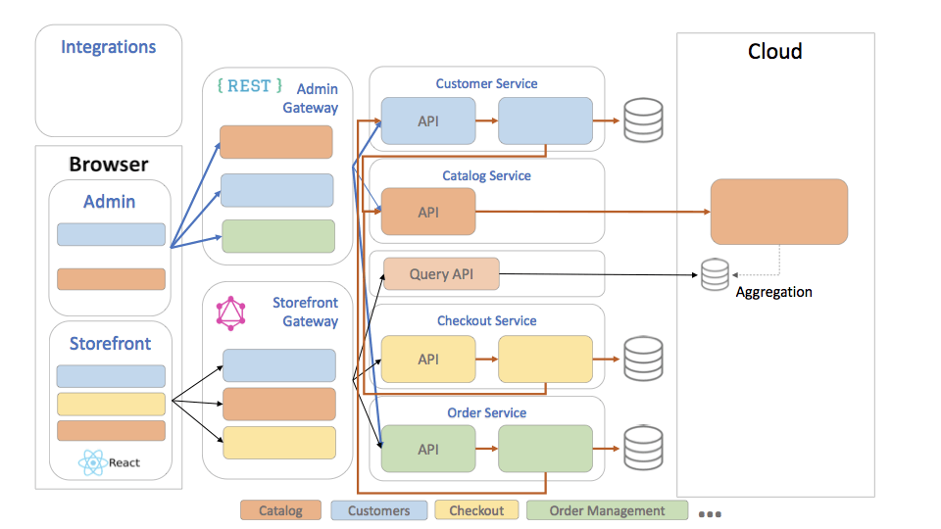
System Architecture

Slide 7
Live Demo of Project

Slide 8
Video of Project Demo

Slide 9
Conclusion
In this part of the dissertation we are going to sum up some conclusions that can be reached after the research that has been conducted. First of all, as we saw earlier, the most dynamic target group for Fashion and Beauty e-shops are Women aged 25-34, who are the 35% (Chart 3) of the people who took the survey, with 31% of them (Chart 9) also stating that they visit e-shops of these sectors 2-3 times a week, pointing out once again that they are the group that drives the revenues of these sectors’ e-shops. Additionally, we see that the Search Bar appears to be of very crucial importance to the visitors of e-shops, with more than 50% percent (Chart 17) of the survey’s participants saying that they use it often or very often. This is a hint for e-shops that the Search Bar should be always available and visible for their visitors, in order to simplify their navi_x0002_gation and enhance their experience throughout to the checkout process. Another fact that is worth mentioning is the function of the Chat-Bot, which is very much related to the Search Bar, since both of them are there to provide assistance to the users for finding what they are looking for. In contrast with the familiarity that the par_x0002_ticipants seem to have with the Search Bar function, the same does not apply to their relationship with the Chat-Bot (Live-chat) function, that most of the e-shops nowadays provide to their users. The results have shown that 1 out of 2 (Chart 18) participants (almost 50%) said that they have never used this function, making it obvious that there is significant room for improvement and further familiarization of Greek users with this very useful function.

Slide 10
Future Scope
Despite the fact that Conversion Rate Optimization is a topic that has been referred to at a significant extent, there is always room for further research and analysis. Especially regarding the CRO that is related with the two sectors which were dealt with in this dis_x0002_sertation, namely the Fashion and the Beauty e-commerce sectors, there is significant space for research. A suggestion for future work could be for the survey to be taken at a more multicultural sample, for example at a wider European level, possibly conducted by a European insti_x0002_tution, in order to find out the differences in the prism through which the citizens of different countries or parts of the continent look upon some usability factors and ele_x0002_ments. For example, it would be useful to see if the citizens of north European countries are more familiarized with the Chat-Bot function than Greek users are, and examine the
reasons for that difference.
Another element that could be examined through the users’ survey is if their behavior towards e-shops that also have a brick-and-mortar presence is similar to the behavior towards e-shops that are available only online.A final suggestion would be the combination of various research tools, for example of a survey and some experts’ interviews, and maybe the application of the findings on a
model for further validation of the results.

Slide 11
Thank you!
Notes:
thank you very much for joining this PPT, keep learning.
11

